Slide 1


Phase 2 Presentation
Azure Data Engineering Project

Slide 2
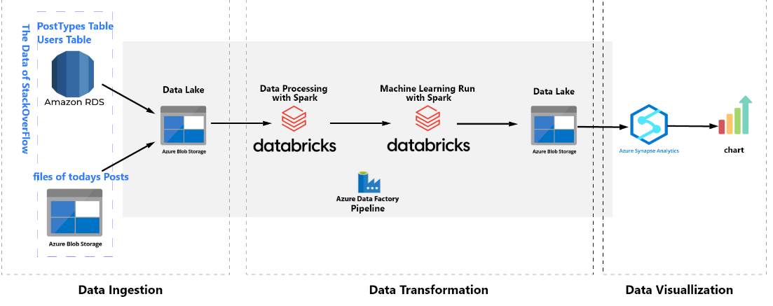
Project Overview

Slide 3
Stage 1: Data Ingestion
Created separate resource group for the project so that we can delete the resource group after completing the project to avoid being further charged.
Created a storage account, a container, and folders to accept the files from the data sources. It’s noted to create a data lake instead of a simple blob storage by ticking on the Enable hierarchical namespace. The folder postTypes accept the table postTypes on PostgreSQL; The folder Users accepts the table Users on PostgreSQL; The folder Posts accepts today's Parquet files. In addition, we need to empty the folders prior to copy the data in these folders.
Created 3 linked services:
Linked Service 1: link the RDS PostgreSQL database
Linked Service 2: link WeCloudData's public storage blob
Linked Service 3: link my storage blob
Created 6 datasets:
2 source dataset - from postType and User
2 sink dataset represent the sink at my blob storage
1 source dataset - from wecloud public storage
1 sink dataset connected to the Posts folder on my blob storage.

Slide 4
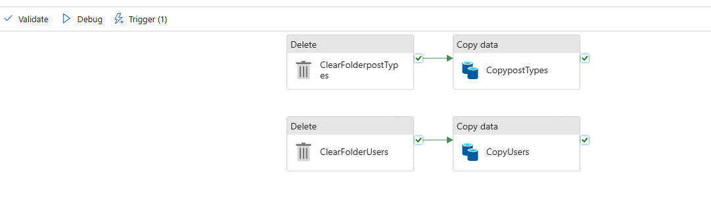
Stage 1: Data Ingestion
Created a Data Factory Resource with 2 pipelines: copyOnceWeek and copyPostsEveryday
pipeline 1: copyOnceWeek. The trigger is set to run the pipeline once per week.

Slide 5
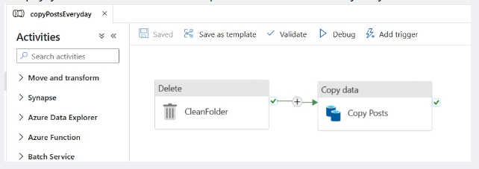
Stage 1: Data Ingestion
pipeline 2: : copyPostsEveryday. The trigger is set to run the pipeline daily.

Slide 6
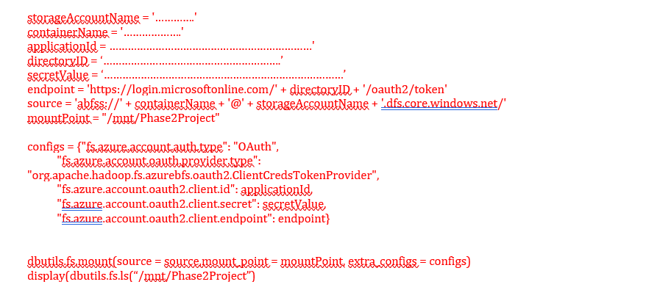
Stage 2 – Data Transformation
Step 1: mount Azure storage to Azure Databricks
Create Databricks workspace, then compute, and notebook
In Azure, allow the Azure Databricks to access the storage container.

Slide 7
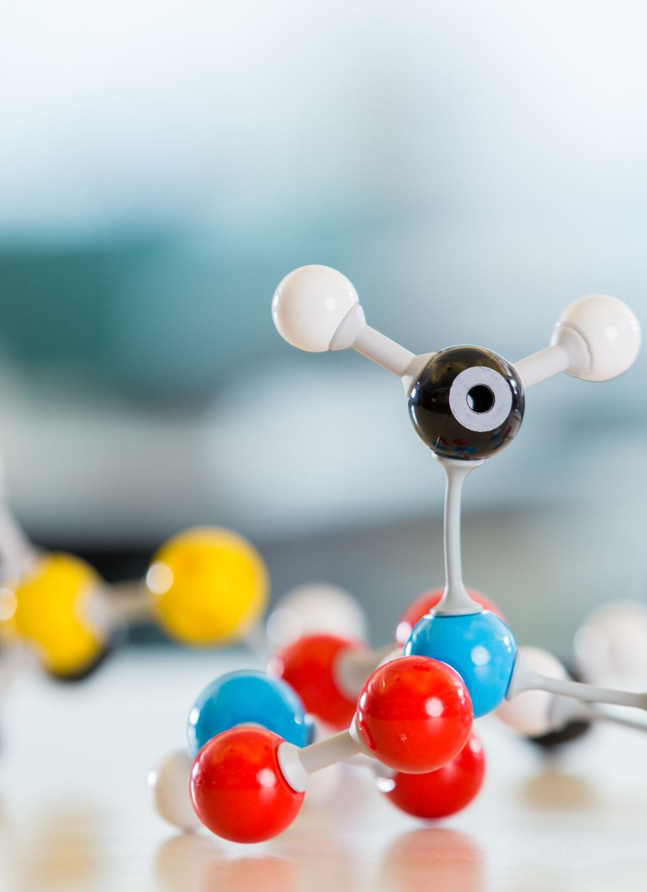
Stage 2 – Data Transformation
Step 2: to train a machine learning model. The model will use data copied from the everydayCopy Posts pipeline and copyonceWeek pipeline to tell us what each post is about (the topic of the post).
Joined the Posts and posttypes tables, because we need to use the Type column in the posttypes table to filter out the posts in Posts table we want.
Cleaned data for the model training;
Trained the machine learning model;
Saved the model to an Azure storage folder so that we can use it in Step 3.

Slide 8
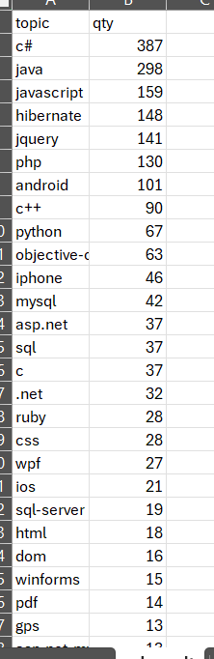
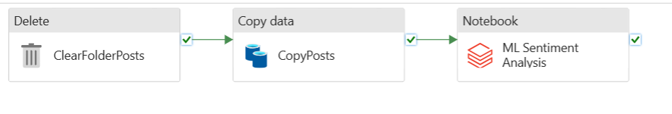
Stage 2 – Data Transformation
Step 3: sentiment analysis

Slide 9
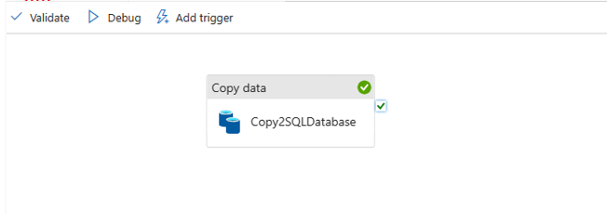
Stage 3 – Data Visualization
Copied result to Azure SQL Database, and then connect this data base to Power BI Desktop for data visualization.
I created pipeline #3 to copy data from the blob storage to Azure SQL Database.
Prior to doing so, I created a table in Azure SQL Database:
CREATE TABLE ML_result (topic VARCHAR(MAX), qty INT);
In the copy activity, to set
First row as header
Truncate the table in Azure SQL Database

Slide 10
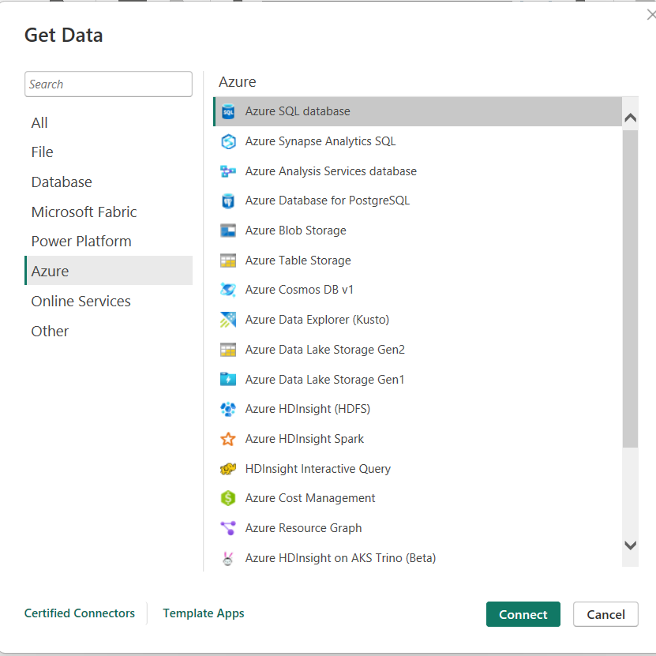
Stage 3 – Data Visualization
Connect Power BI to Azure SQL Database

Slide 11
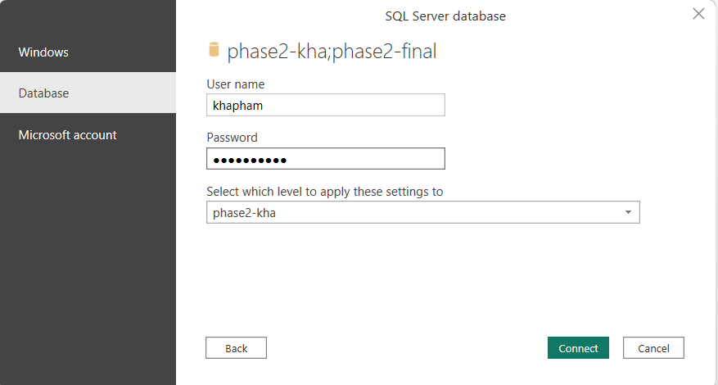
Stage 3 – Data Visualization
In the server name, please make sure to add server name, and the string in red as follows: .database.windows.net

Slide 12
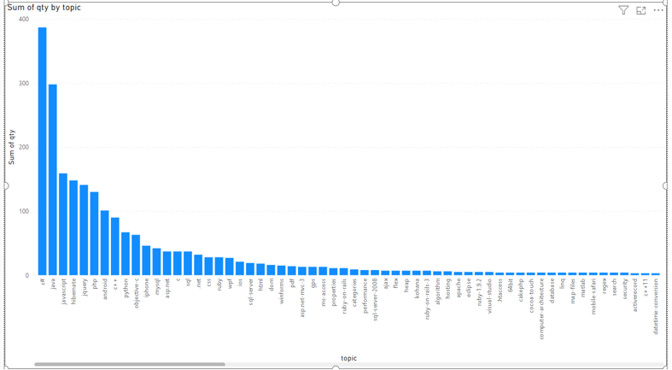
Stage 3 – Data Visualization

Slide 13
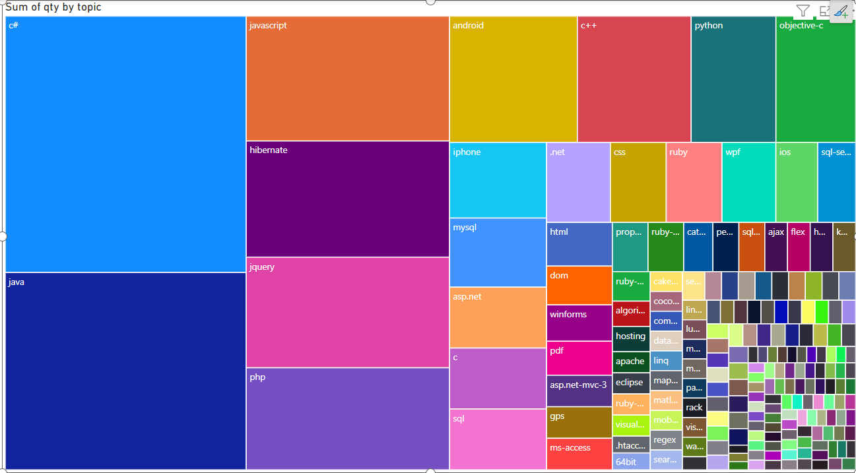
Stage 3 – Data Visualization

Slide 14
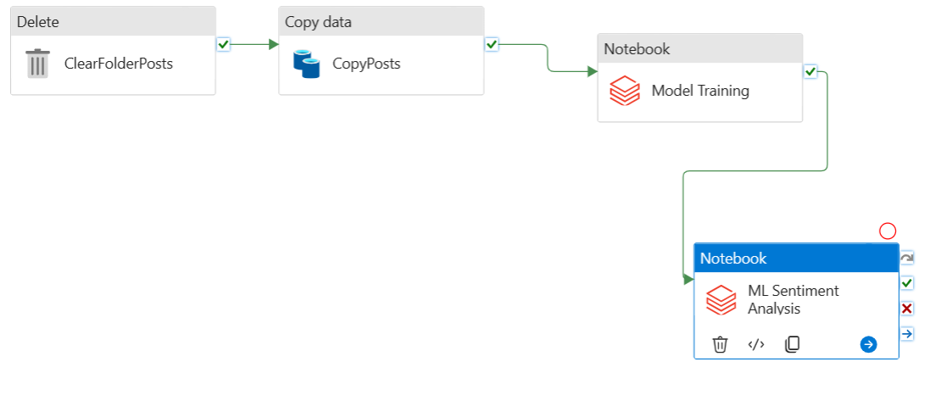
Problems
Lazy Execution of Databricks
Connecting Power Bi to Azure SQL Database: In the server name, please make sure to add server name, and the string in red as follows: .database.windows.net

Slide 15

If I had more time
CI/CD with Azure Dev Ops
Rework the project by using Synapse only

Slide 16
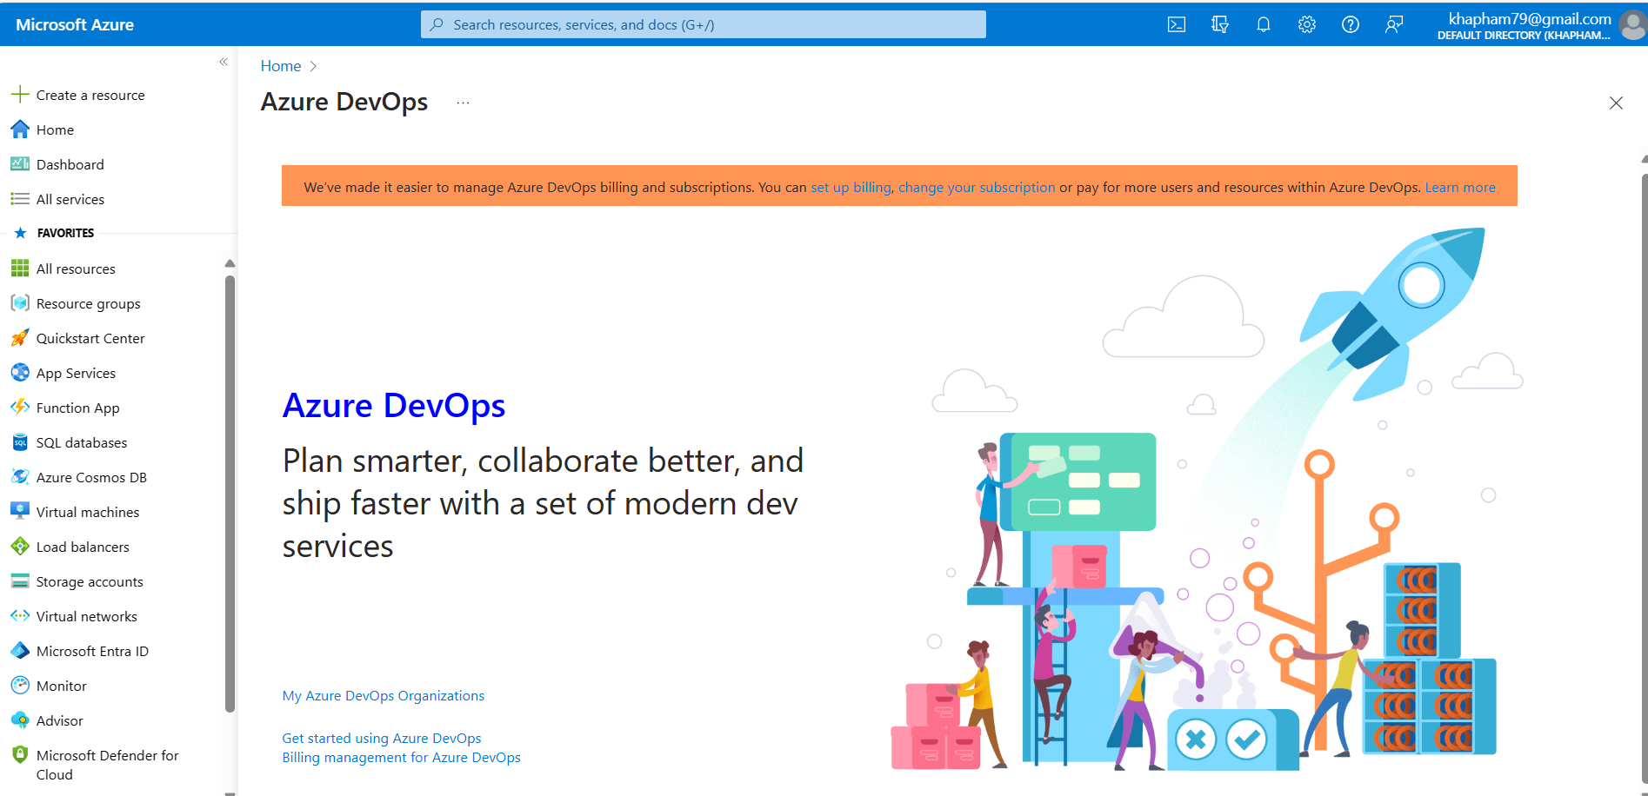
CI/CD with Azure Dev Ops

Slide 17
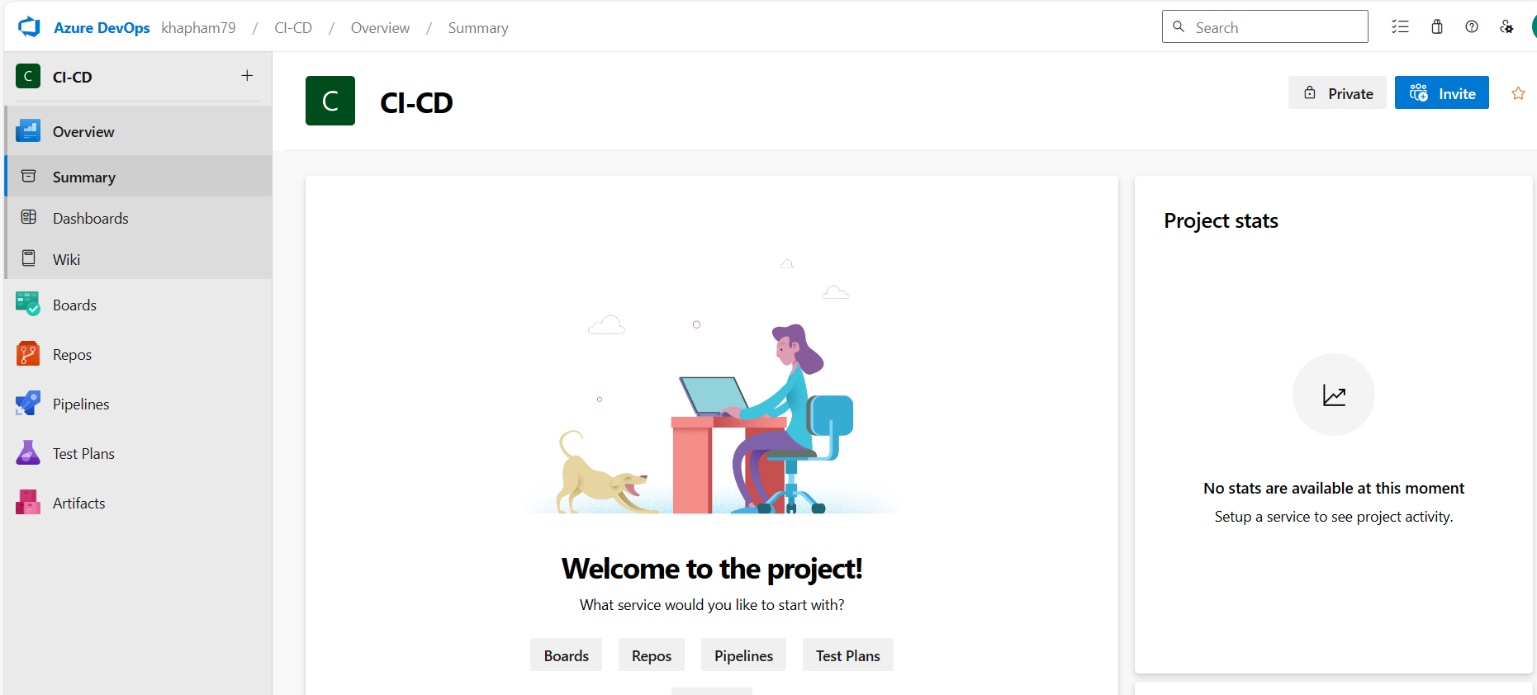
CI/CD with Azure Dev Ops

Slide 18
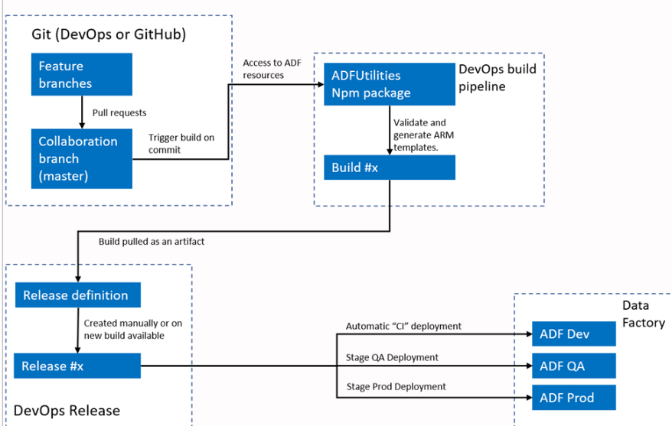
CI/CD Flow

Slide 19
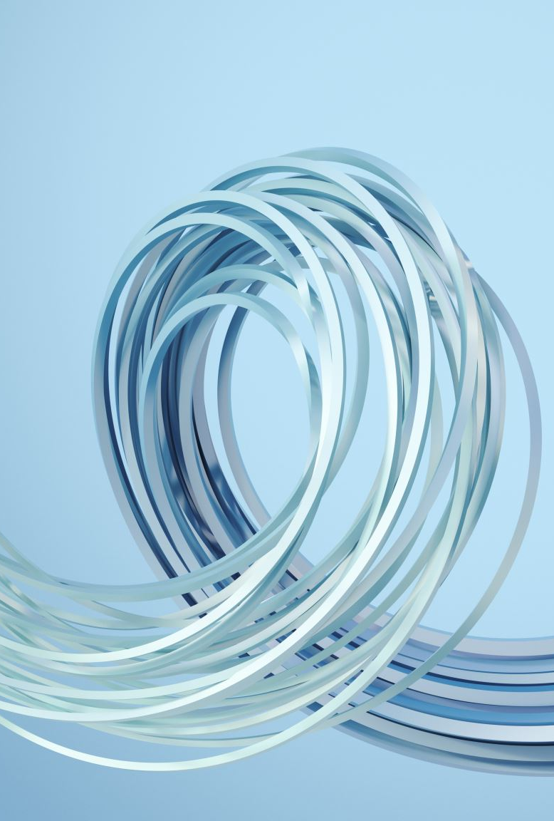
CI/CD Flow
Each user makes changes in their private branches.
Push to master isn't allowed. Users must create a pull request to make changes.
The Azure DevOps pipeline build is triggered every time a new commit is made to master. It validates the resources and generates an ARM template as an artifact if validation succeeds.
The DevOps Release pipeline is configured to create a new release and deploy the ARM template each time a new build is available.
Automated publishing for continuous integration and delivery - Azure Data Factory | Microsoft Learn

Slide 20

CI/CD Flow in detail Step 0
As we need Hosted Parallelism to run pipeline in step 2, this can be requested for free by filling out the form at below link, then submit, and await for approval. Usually, it takes 2-3 days to obtain the approval.
https://aka.ms/azpipelines-parallelism-request.

Slide 21
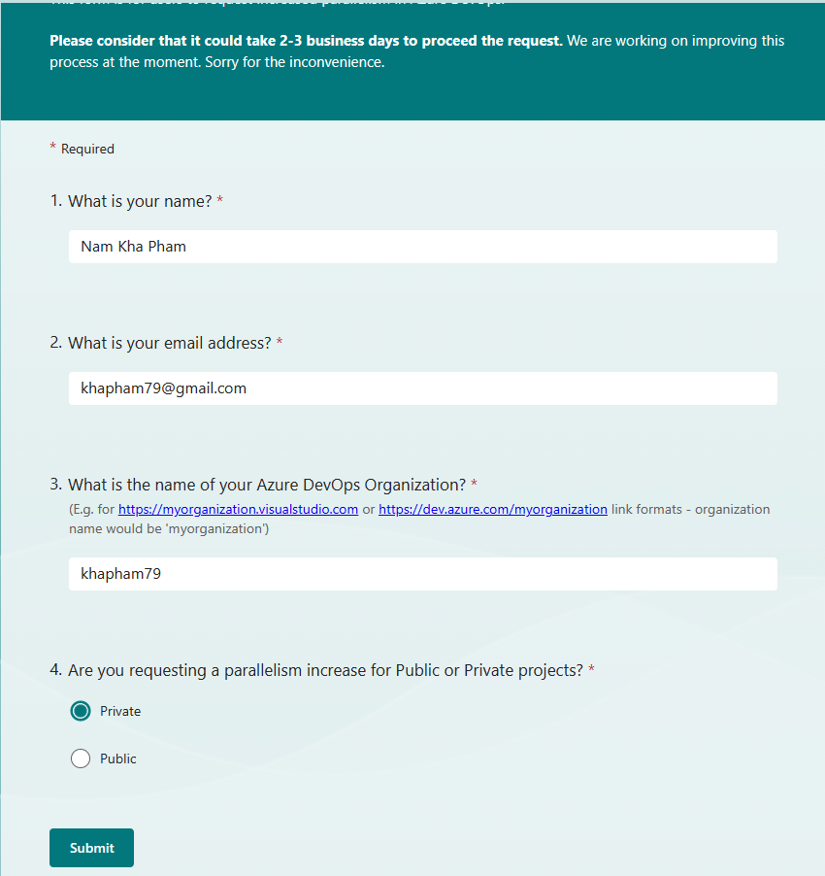
CI/CD Flow in detail Step 0

Slide 22
CI/CD Flow in detail Step 1
Create 3 Data Factory located within 3 different resource group
Development
Test
Production

Slide 23
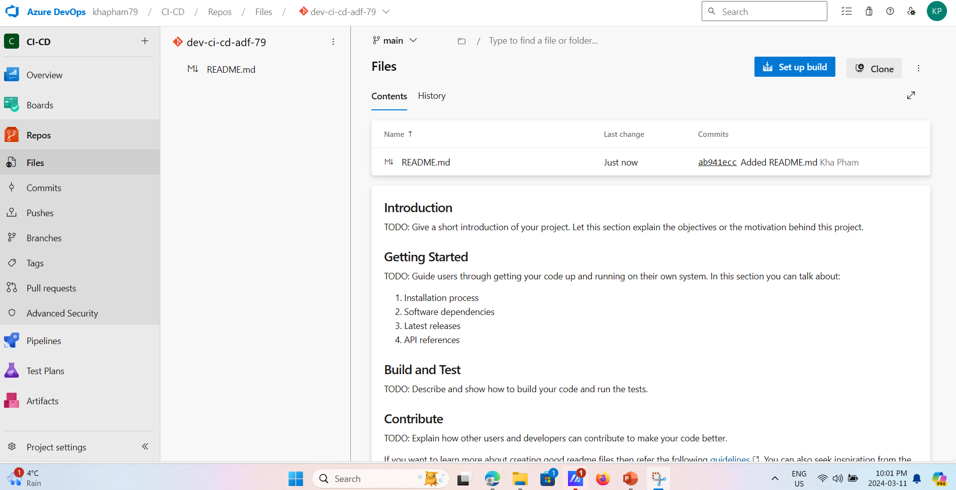
CI/CD Flow in detail Step 2 – Git Configuration
Create Git depository using Dev Ops portal:

Slide 24
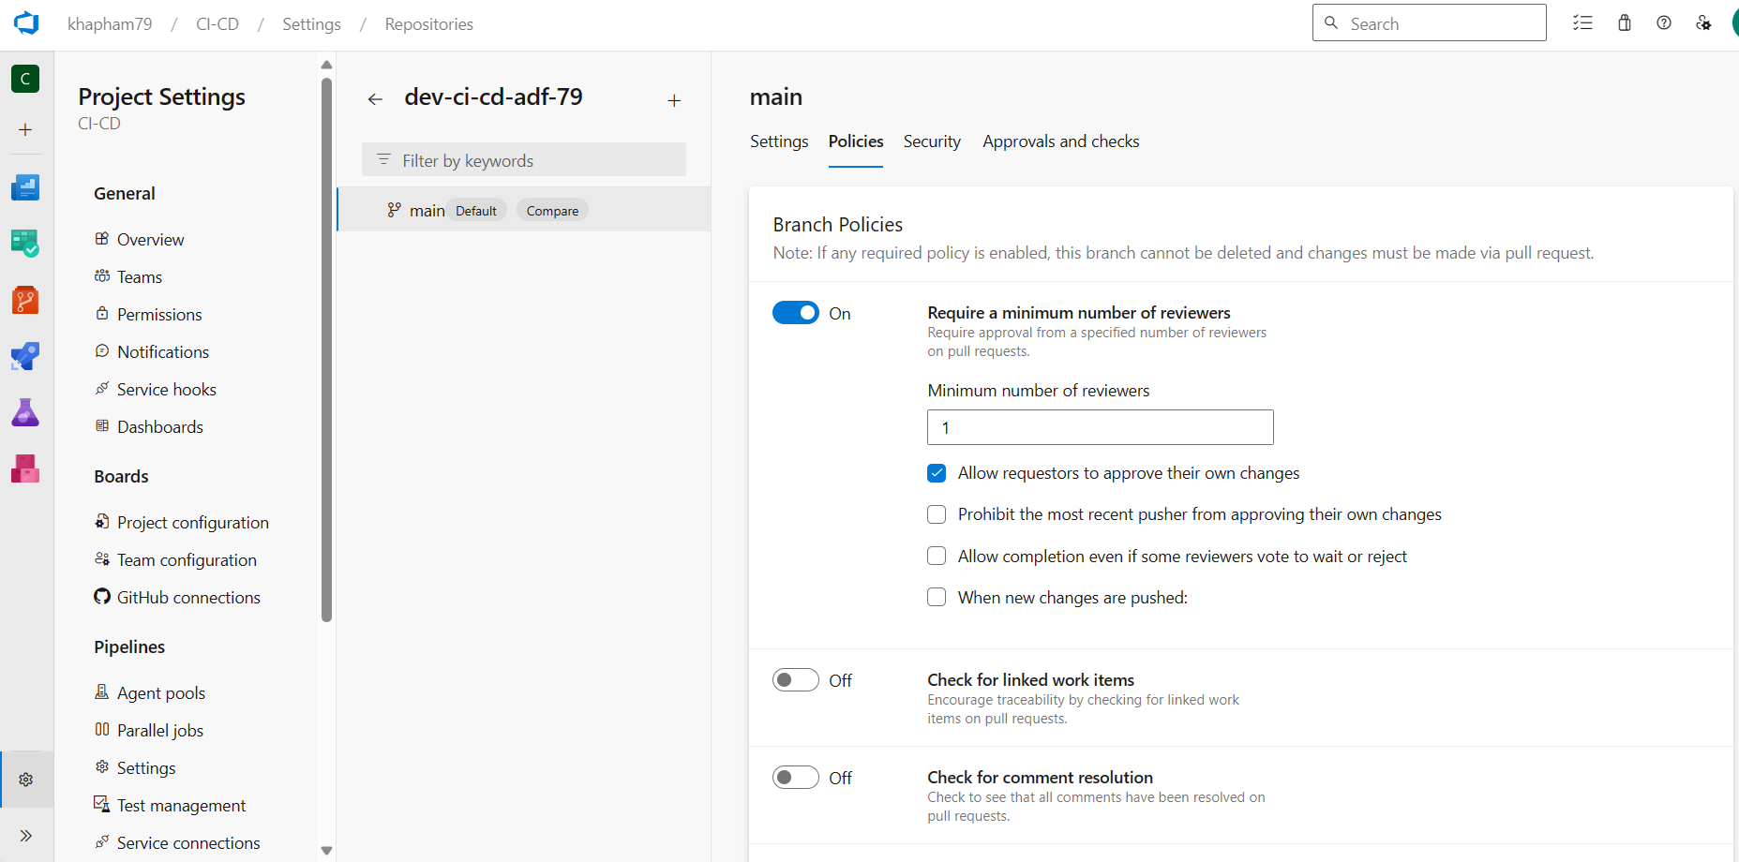
CI/CD Flow in detail Step 2
Create Branch Policy:

Slide 25
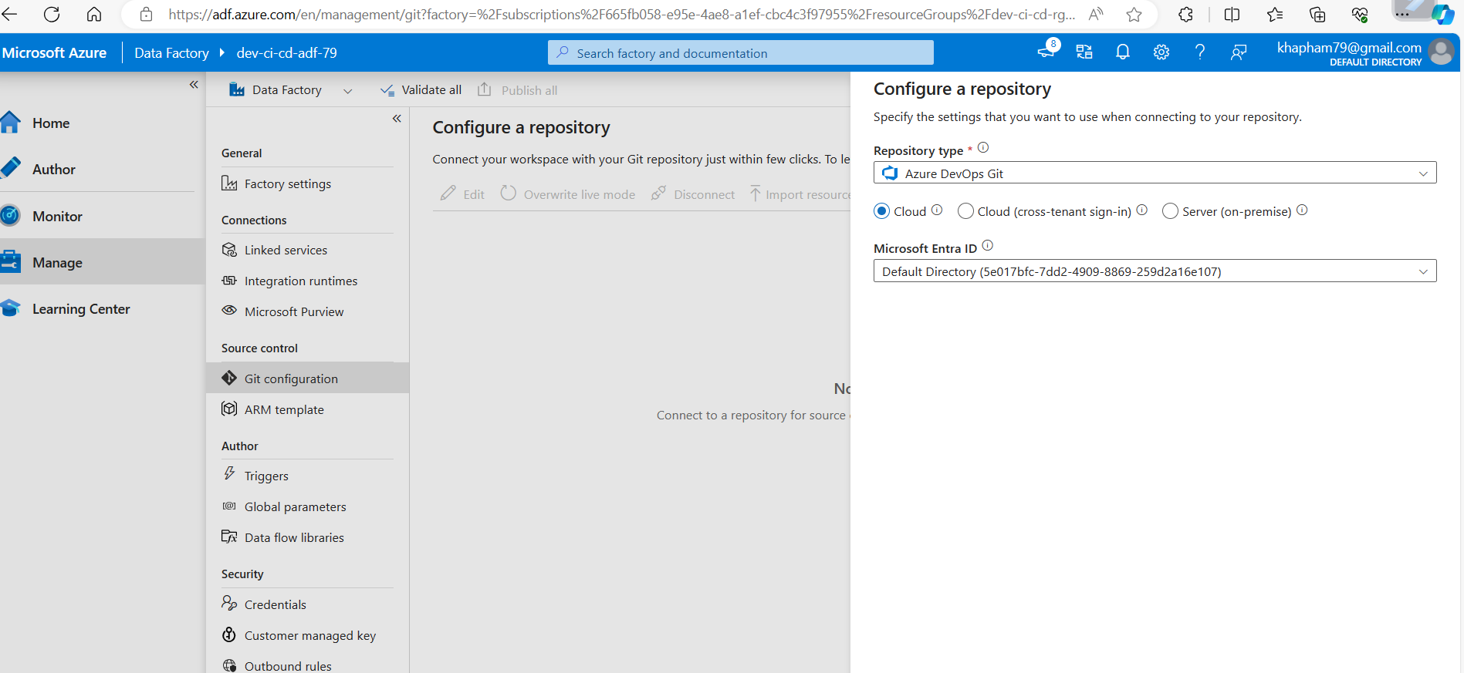
CI/CD Flow in detail Step 2
Configure repository on Development Data Factory:

Slide 26
CI/CD Flow in detail Step 3 – Continuous Integration - CI
Create feature branch in Development Data Factory
Develop pipeline
Debug pipeline
Create Pull Request
Review, approve Pull Request
Complete, and Merge to the main branch

Slide 27
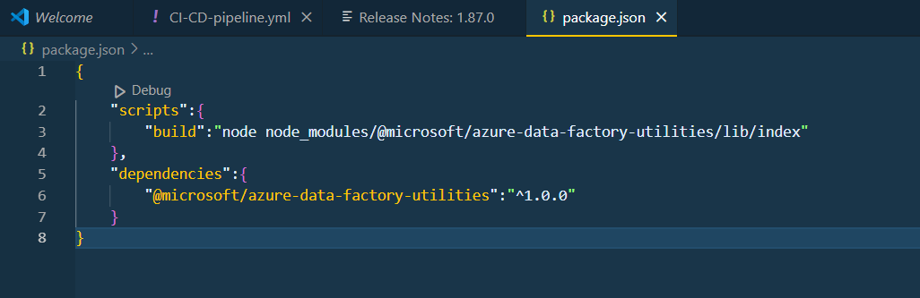
CI/CD Flow in detail Step 4 – Build Pipeline
Create package.json

Slide 28
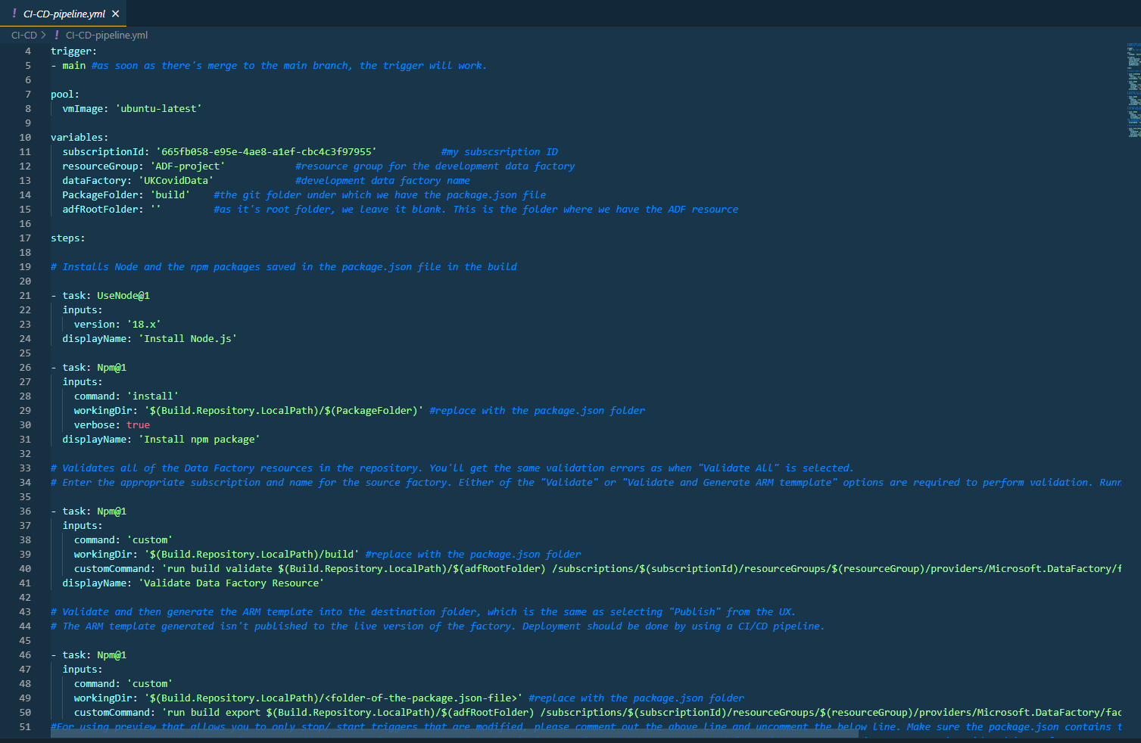
CI/CD Flow in detail Step 4 – Build Pipeline
Create CI_CD_pipeline.yml file. Once done, commit, approve, complete and merge to the main branch.

Slide 29
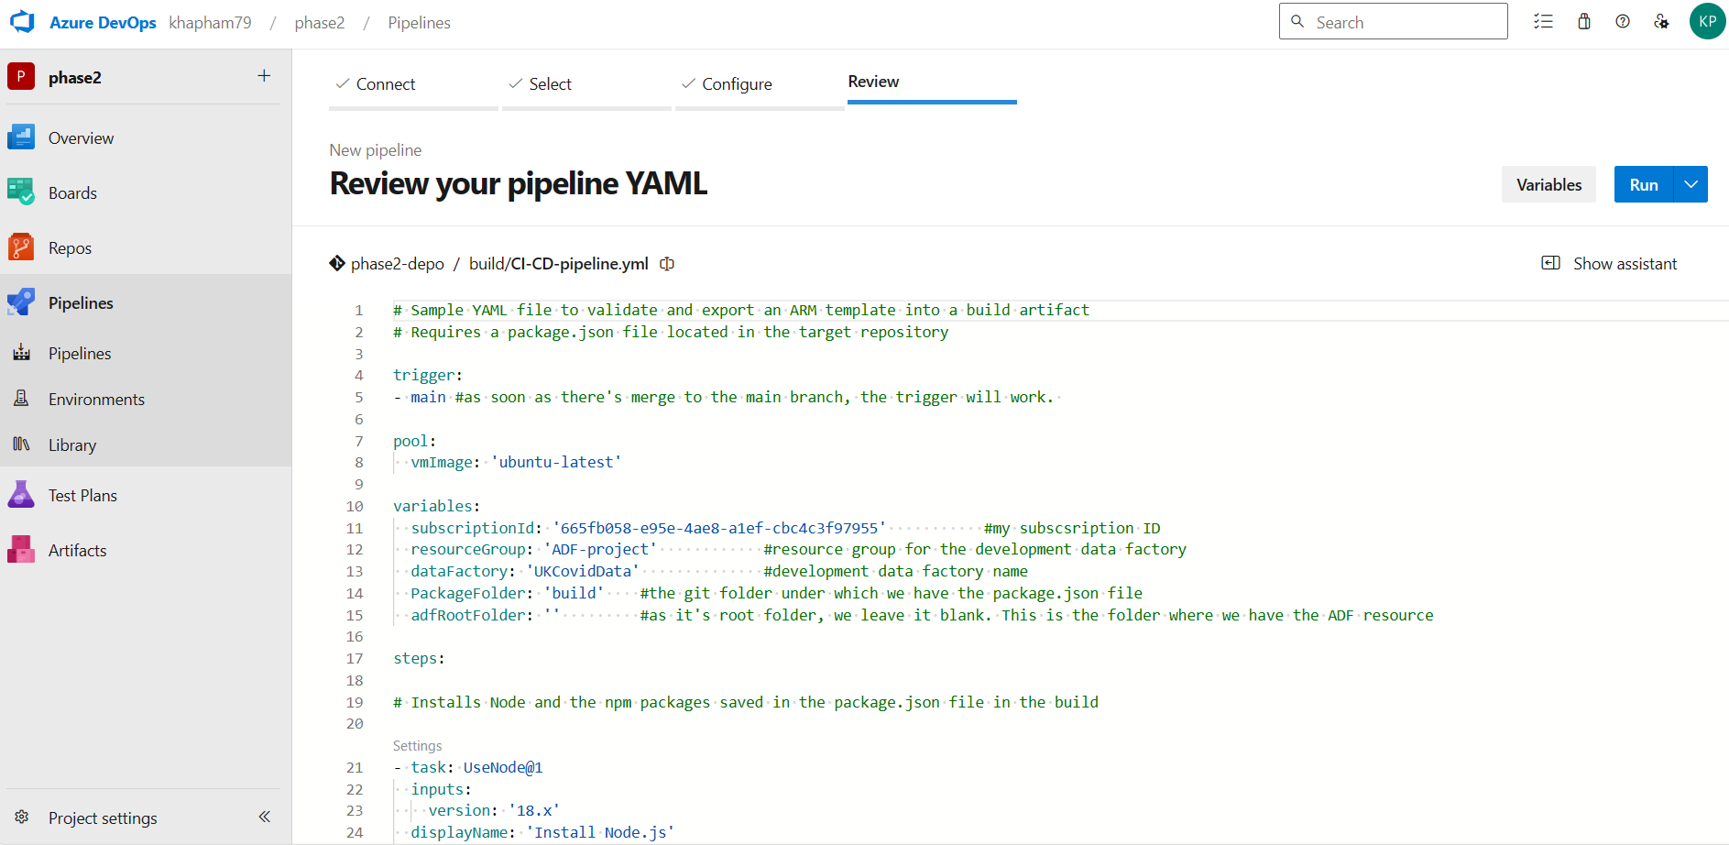
CI/CD Flow in detail Step 4 – Build Pipeline
Create pipeline from existing CI_CD_pipeline.yml file.

Slide 30
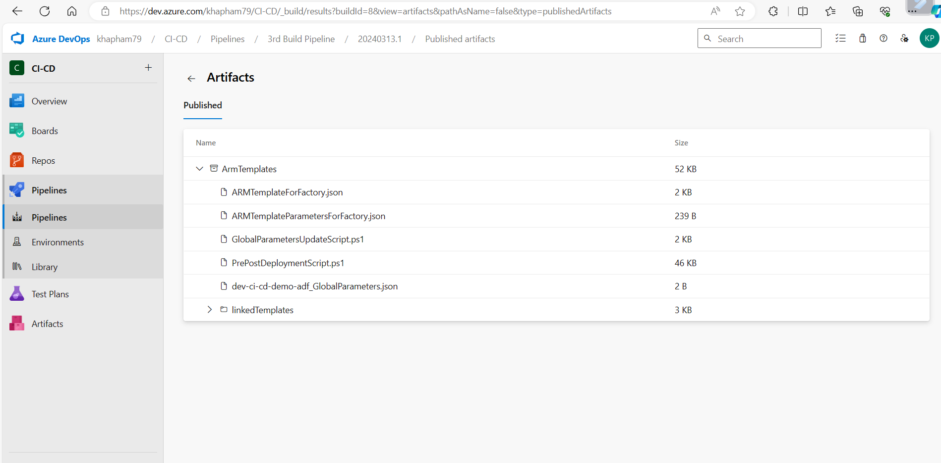
CI/CD Flow in detail Step 4 – Build Pipeline
Run the pipeline to test if it work or not.

Slide 31
CI/CD Flow in detail Step 5 – Release Pipeline
Create Release Pipeline
Add an artifact in which the source will come from build pipeline
In the Test task, change the ARM template from the repository to the ARM template created by the build pipeline -> select the ARM templateFor Factory.json, and the same for the parameter as well.
Enable the trigger for the Release Pipeline (upon completion of the build pipeline) -> click on trigger for the artifact under the release pipeline.

Slide 32





Thank you!

